Slide 1
“
Building Damage Extent ASSESSMENT
”
Team Member: Yuan Chang, Jiachen Huang, Maaheen Yasin

Slide 2
CONTENTS
PART 01.
Project Objectives
PART 02.
Methodology
PART 03.
Proposed Solution
PART 04.
Conclusion

Slide 3
Project Objectives
PART 01.
Project Overview

Slide 4
Objective
What are the most efficient methods for assessing disaster damages?
Goals:
Identify efficient approaches for disaster damage assessment.
Enable rapid and accurate understanding of damage extent.
Methods：
Satellite Imagery
Deep Learning Model
Automated segmentation and classification of building damage

Slide 5
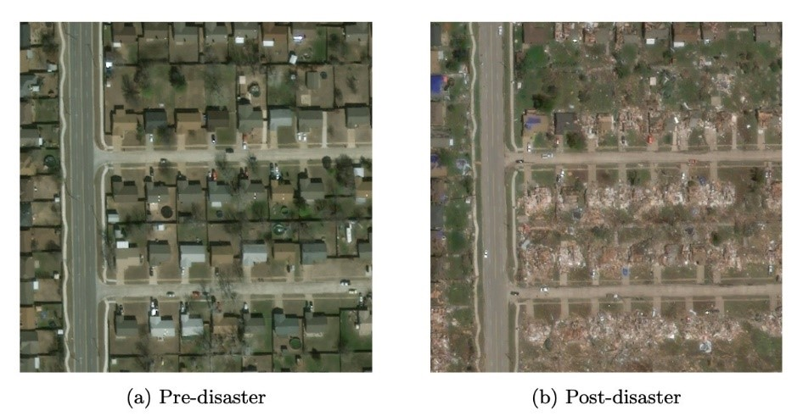
Satellite Imagery
Provides a powerful means to assess widespread disaster damage.
The xBD dataset

Slide 6
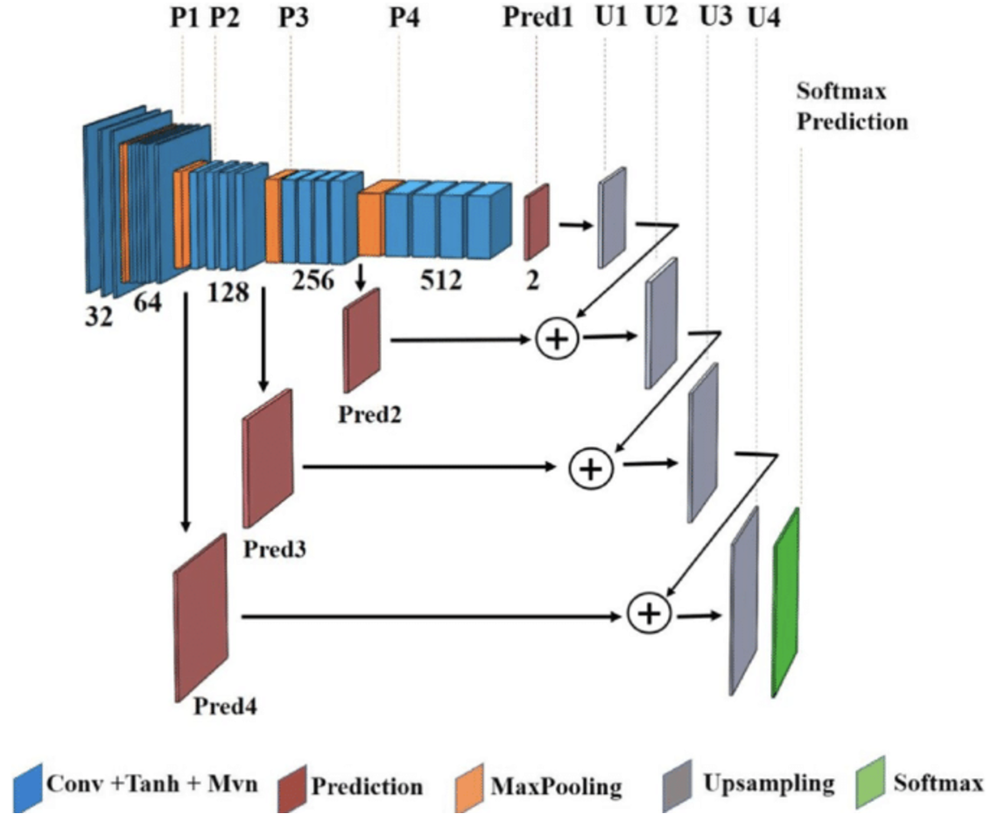
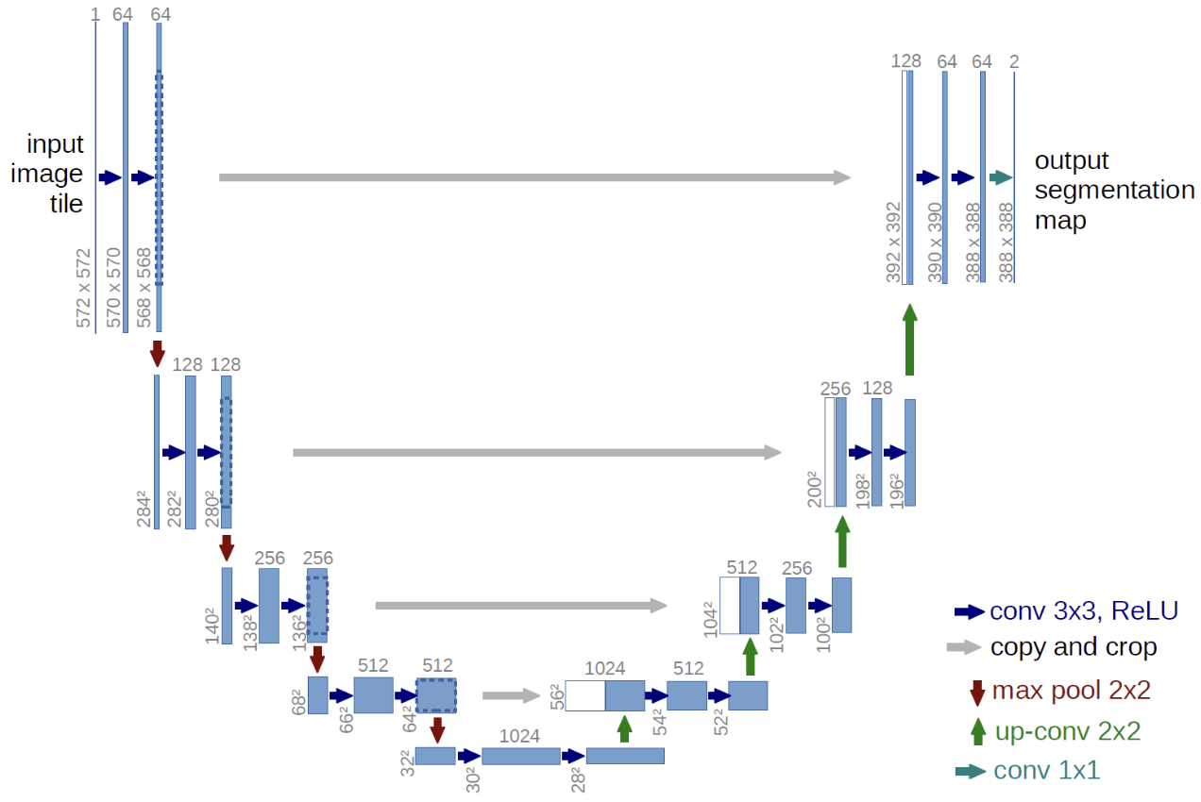
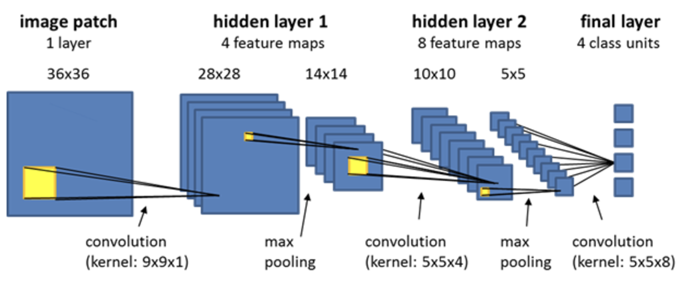
Deep Learning Models
Apply deep learning models to predict damage
Performance evaluating metrics (e.g. F1 score)
CNN
U-NET
FCN

Slide 7
PART 02.
Methodology
Overall Pipeline

Slide 8
Overall Pipeline
Dataset Source: xBD dataset
Dataset split
Image transformation
Data Preprocessing
Modelling
Training
Evaluation
Building Detection (Localization)
Damage Classification
Model selection
Architecture Design
Loss Function
Optimizer
Evaluation Metrics: F1 score, IOU
Performance Assessment
Visualization

Slide 9
Preliminary Solution
PART 03.

Slide 10
Preliminary Data Processing
Dataset:
xBD Dataset
Structure:
Pre-disaster and post-disaster image pairs.
JSON files containing labeled building polygons and damage classifications.
Processing Steps
Extracting Labels:
Parsed JSON files to retrieve polygon annotations and damage labels.
Damage levels categorized as No Damage, Minor Damage, Major Damage, Destroyed.
Generating Masks:
Created binary masks for each post-disaster image.
Masks represent the ground truth for model training.
Output:
Aligned masks in a separate folder.
Extracting Data From JSON Files
Generating Polygons For All Coordinates Extracted
Generate Masks
Save Masks In A Separate Folder

Slide 11
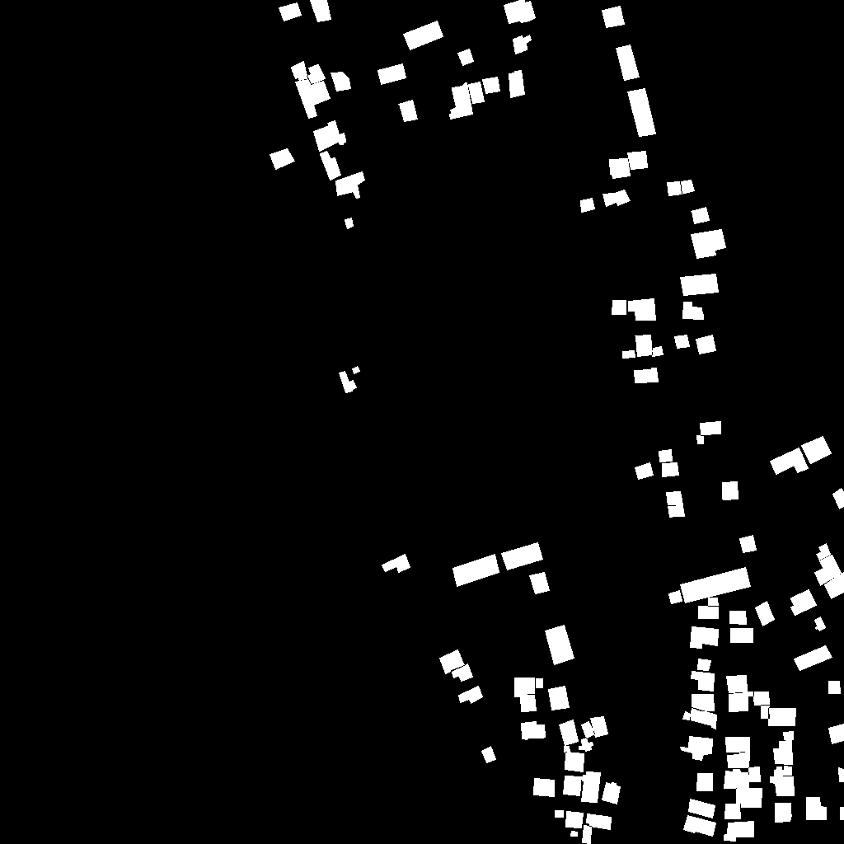
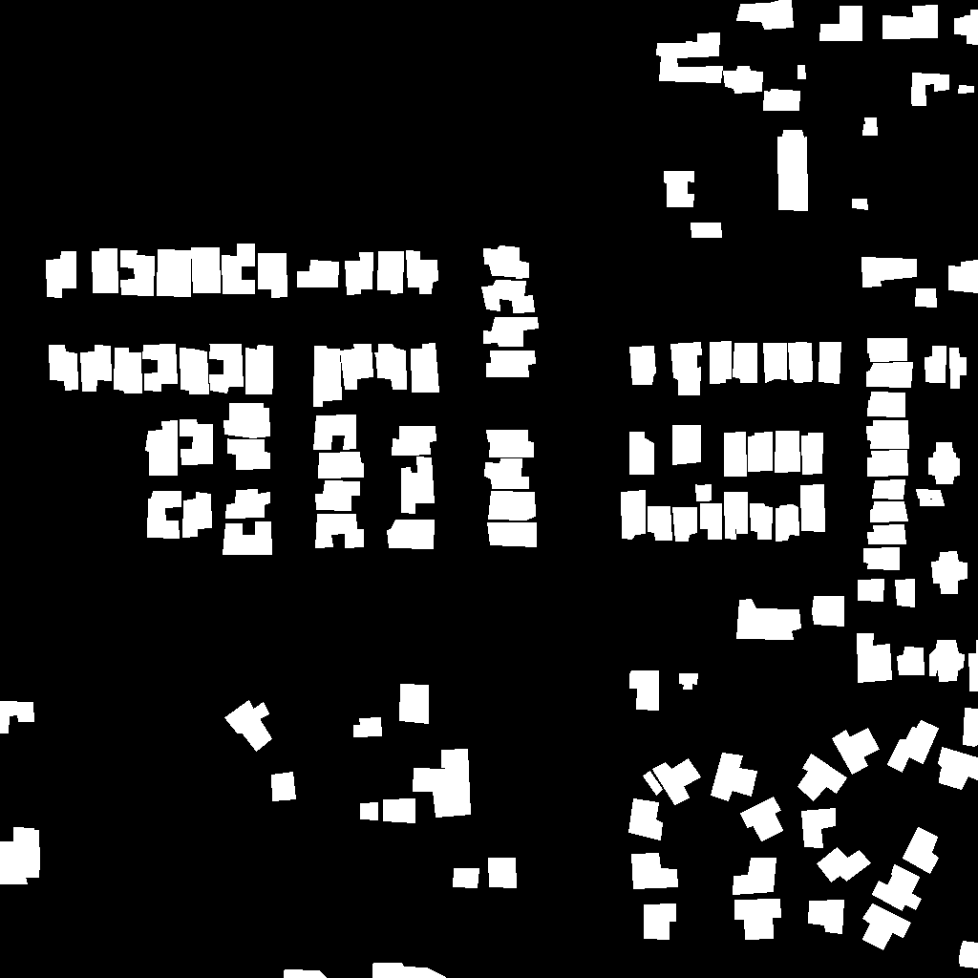
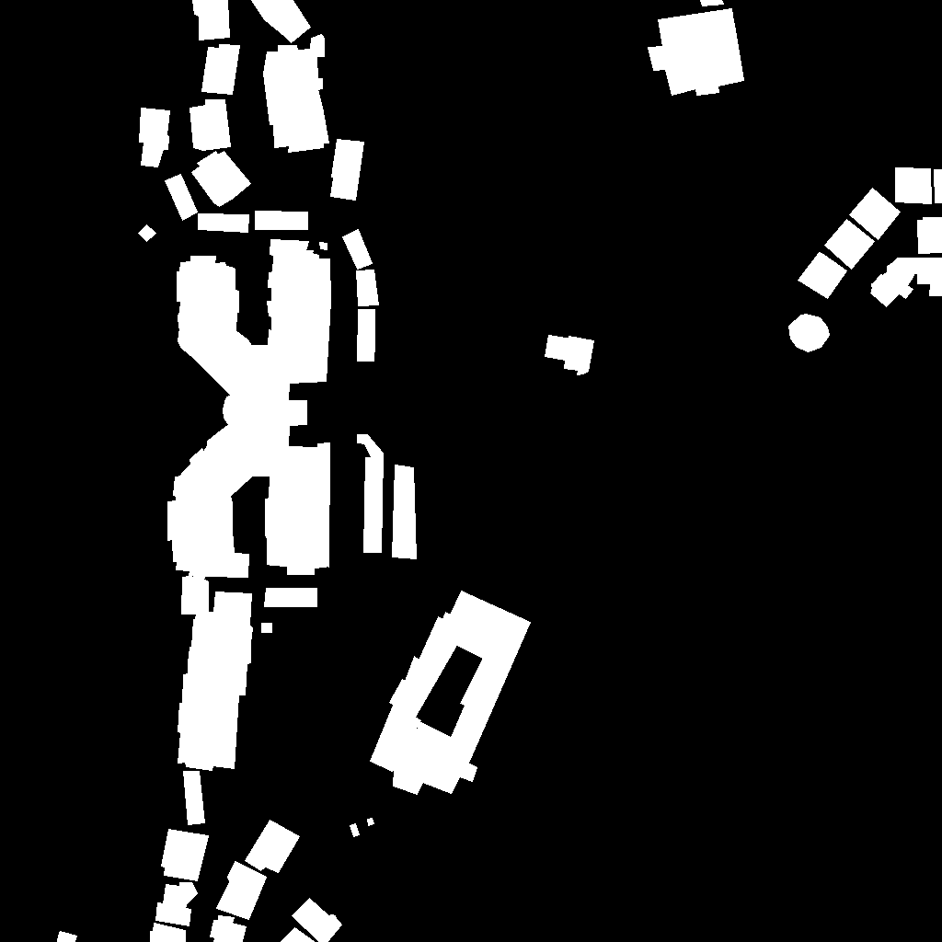
Preliminary Data Processing
Mask generated using mask_polygon.py file

Slide 12
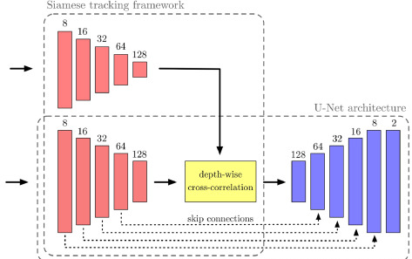
UNet-Based Model for Damage Assessment
Model Architecture:
Dual Encoder: Two separate encoders process the pre and post images to extract hierarchical features through convolution and max-pooling layers.
Decoder: Combines spatial and semantic features from both encoders using upsampling, skip connections, and feature fusion techniques to reconstruct pixel-wise details.
Final Layer: Outputs damage classification for each pixel (No Damage, Minor, Major, Destroyed) by comparing features from the two input images.
Pre-Disaster Image
Post-Disaster Image

Slide 13
UNet-Based Model for Damage Assessment
Model Workflow
Data Ingestion:
Pre-disaster and post-disaster images are loaded from the dataset, along with their corresponding ground truth masks.
RGB images for both pre- and post-disaster scenarios, and grayscale masks.
Preprocessing:
Images are resized to a uniform dimension.
Transformations (e.g., resizing, normalization) are applied for consistency and better model performance.

Slide 14
UNet-Based Model for Damage Assessment
Model Workflow
Siamese UNet Architecture:
Encoder/Downsampling: Extracts hierarchical features from the pre and post disaster images using convolutional and pooling layers.
Bottleneck: The deepest layer where high-level features from both images are fused to learn shared representations.
Decoder/Upsampling: Reconstructs spatial details for each input branch using skip connections and transposed convolutions.
Final Layer: Outputs a segmentation mask with four classes. (No Damage, Minor, Major, Destroyed)
Training:
Images are processed in batches
CrossEntropyLoss is used to compare predicted masks with ground truth masks.
Adam optimizer is used to adjusts weights to minimize the loss.

Slide 15
UNet-Based Model for Damage Assessment
Model Workflow
Evaluation:
The model predicts the segmentation and damage classification for test images.
F1 score and loss metrics are calculated based on correct predictions vs. ground truths
Visualization:
A random test sample is visualized, showcasing the pre-disaster image, post-disaster image, and the model's predicted mask.

Slide 16
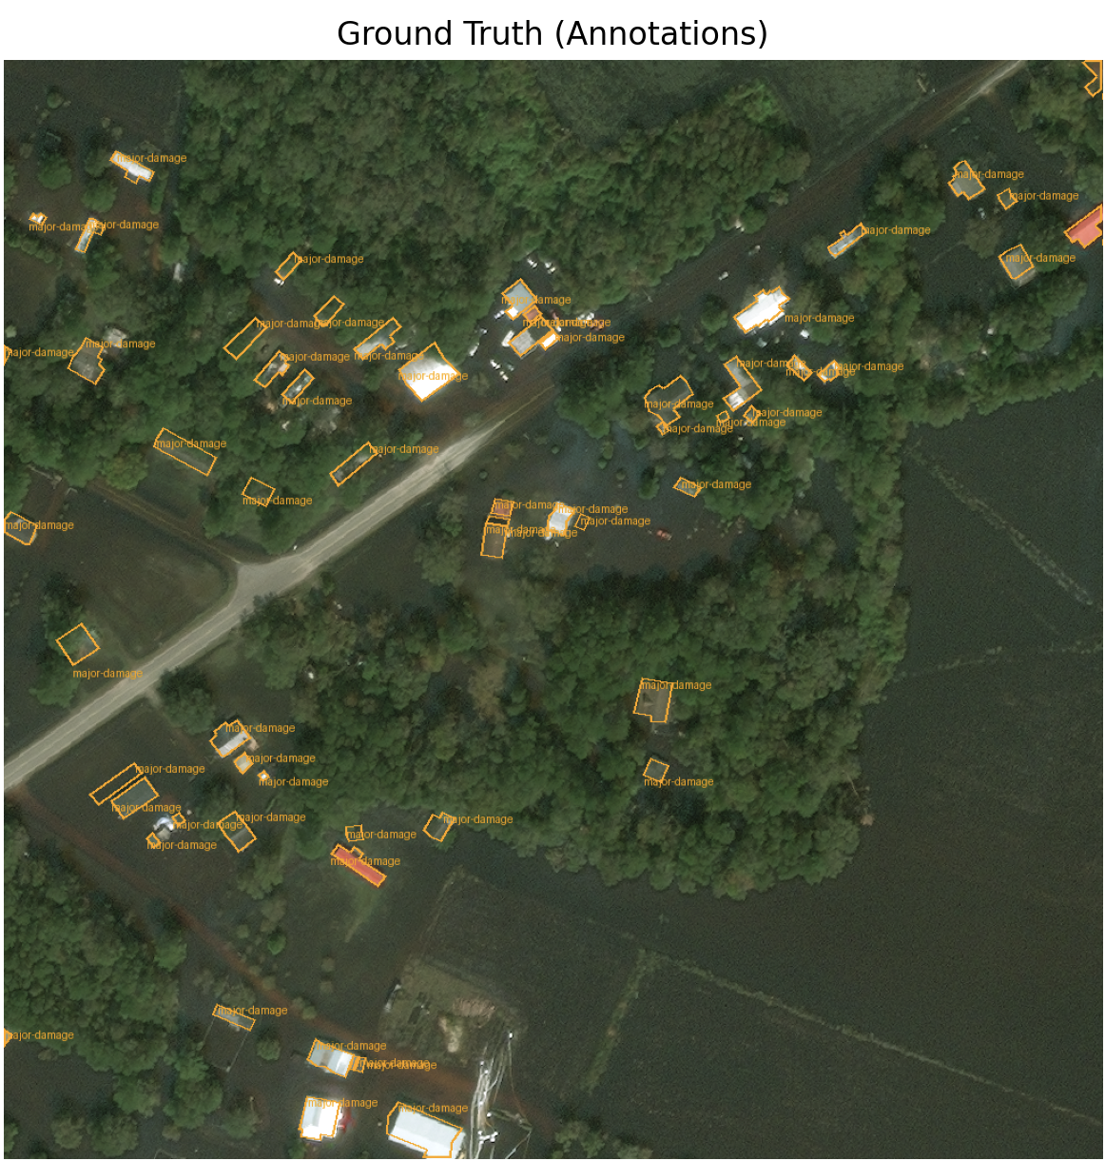
For data part information
Model Architecture - CNN
Data
label_mapping = {
0: "no-damage",
1: "minor-damage",
2: "major-damage",
3: "destroyed"}
Data split：
Training Set
Validation Set
Test Set
Preprocessing Steps
Image Resizing:
Resize images to a fixed size (e.g., 256×256 or 1024×1024).
Apply data augmentation (e.g., rotation, flipping, cropping) to improve generalization.
Label Conversion:
Parse JSON annotations to extract damage labels for each building.
Map class labels to numeric values for model input.

Slide 17
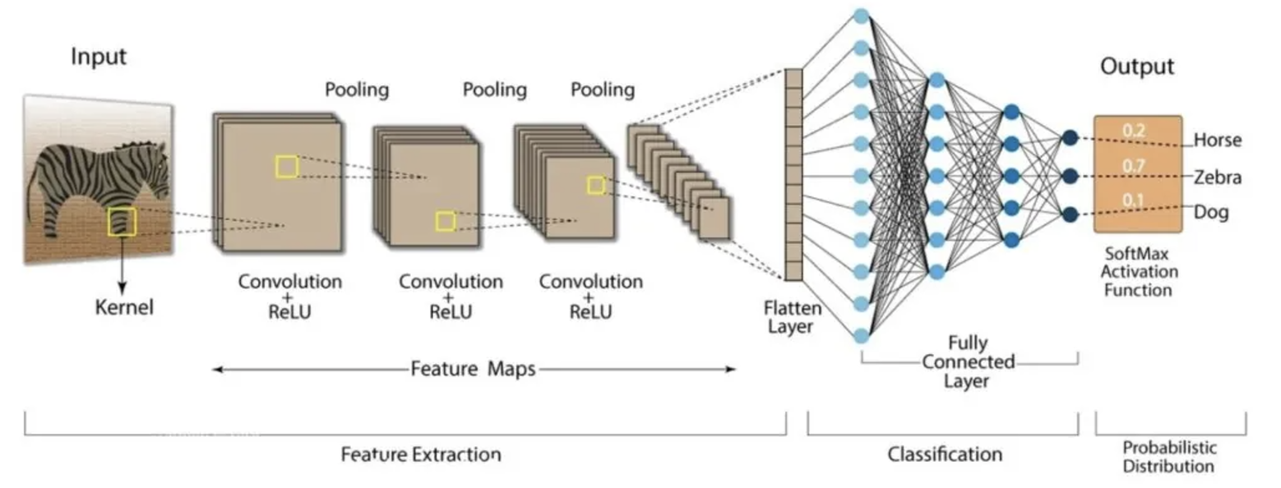
Model Architecture - CNN
Input layer
Convolutional Layers
Activation Function Layer
Pooling Layers
Fully Connected Layers
Output Layer
Why CNN?
Automatic Extraction of Local Features and Spatial Relationships
Flexibility of Transfer Learning

Slide 18
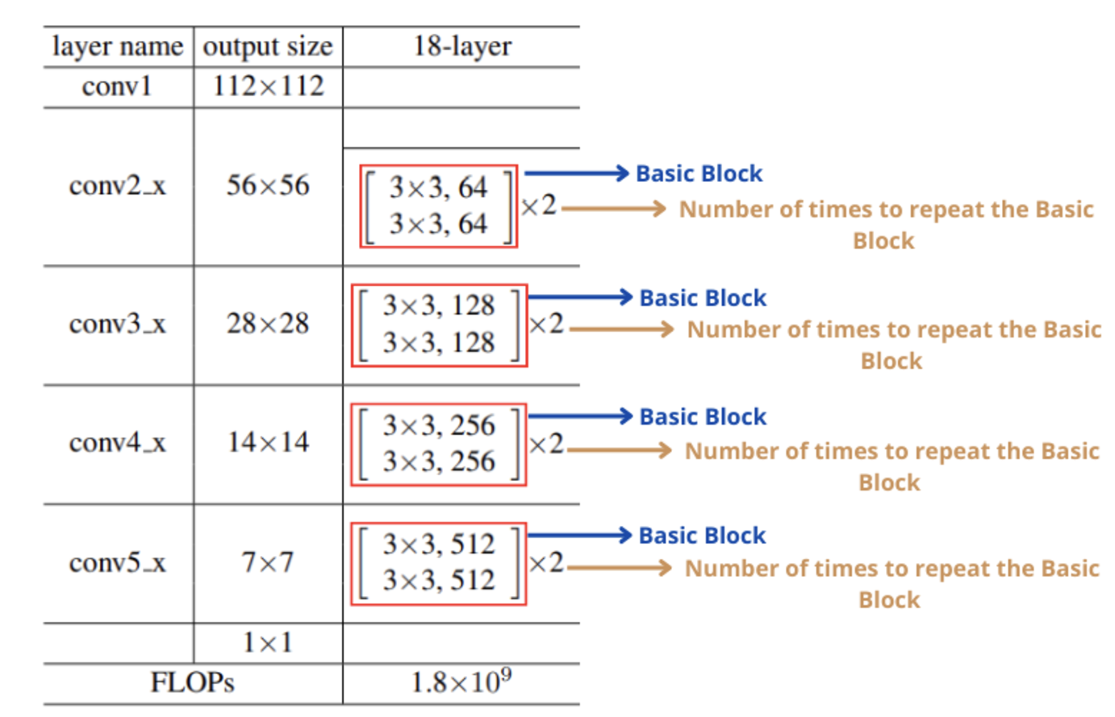
Model Architecture - CNN
CNN Architecture (ResNet Integration)
Base Model: ResNet18
Pretrained Weights:
Leveraging ImageNet-pretrained weights accelerates convergence.
Residual Connections:
Prevent vanishing gradient issues in deep networks.
Loss Function: Cross-Entropy Loss
Optimizer: Adam Optimizer
Modification:
Replace the fully connected (FC) layer with a custom classification head tailored to your number of damage categories (e.g., "no damage," "minor damage," etc.).

Slide 19
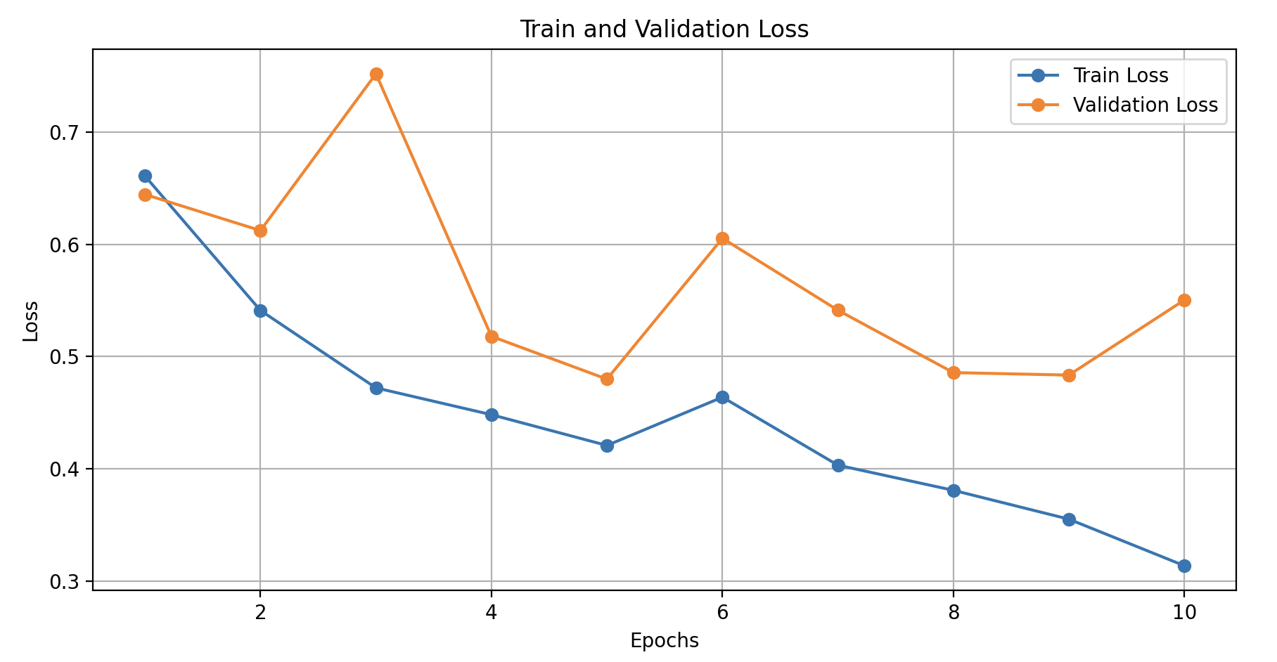
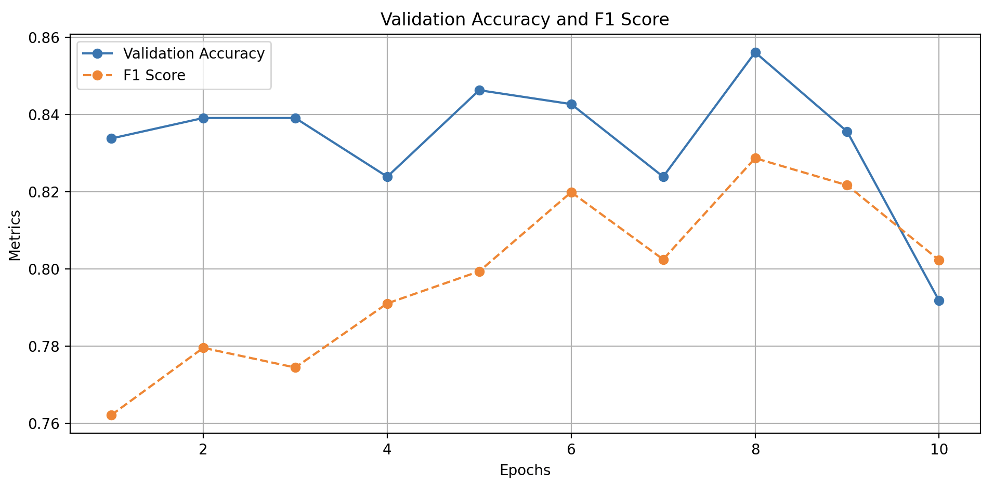
Model Assessment
Parameters：
Batch size = 32
Epoch = 10
Learning rate = 0.001
Training and Validation Loss:
Monitor learning progress.
Validation Accuracy and F1 Score:
Evaluate model's classification and localization performance.
Deployment
Save the trained model as a disaster_model.pth file.

Slide 20
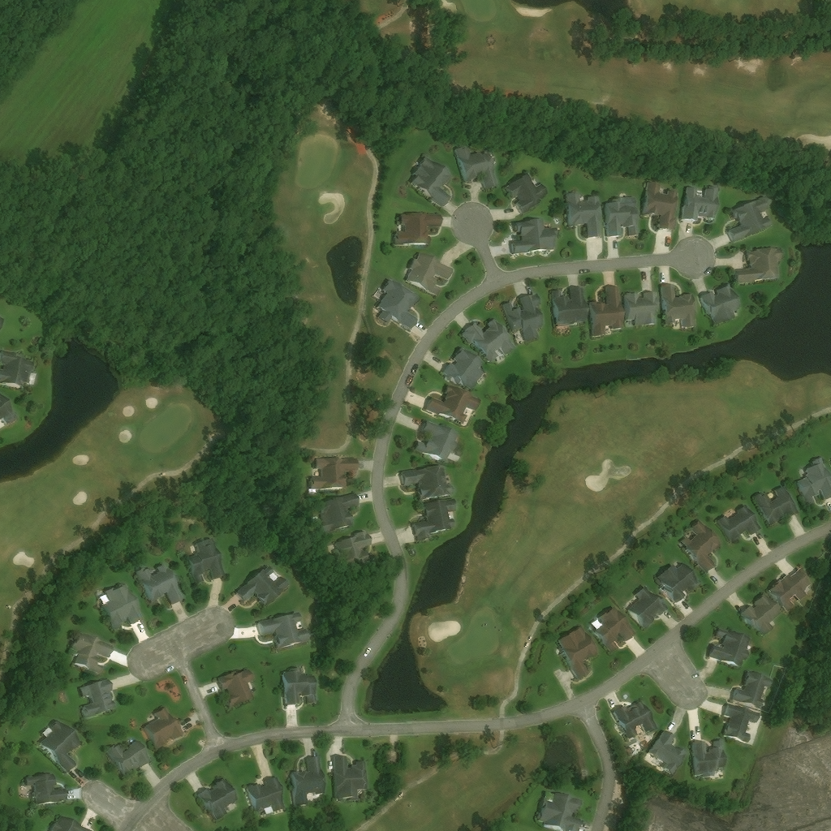
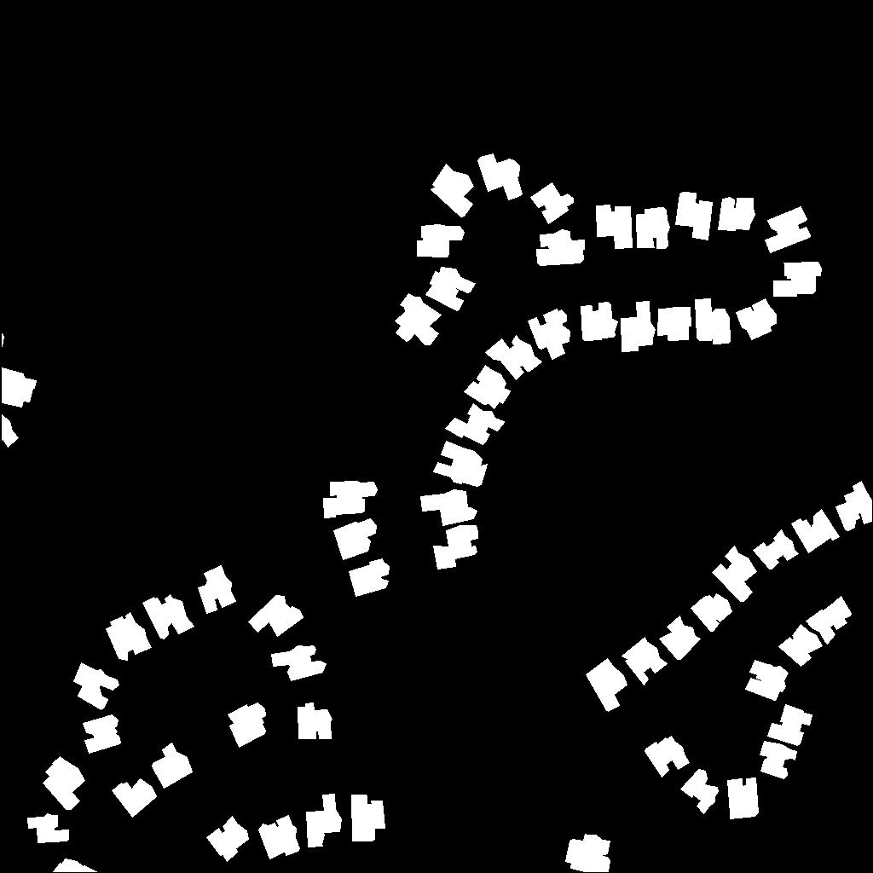
Model Design - FCN
See if the images can be used for dataset, not plan to include inside my part
Input：
Pre-disaster Satellite images
Ground truth masks

Slide 21
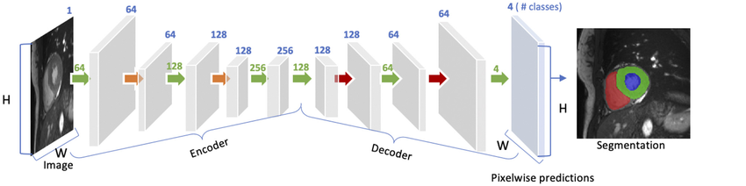
Model Design - FCN
Input
Pre- and post-disaster satellite images
Ground truth segmentation masks for training (Pixel level)
Output
A segmented map with pixel-level classification
How it works
Feature Extraction
Downsampling
Upsampling
Notes:
Transposed Convolution

Slide 22
Model Design - FCN
Layer | Operator | Dimension (H x W x Depth) | Output Channels
Input |  | 256 × 256 × 3 | 3
Layer1 | Conv1 w/ReLU | 256 × 256 × 64 | 64
 | Max Pooling1 | 128 × 128 × 64 | 64
Layer2 | Conv2 w/ReLU | 128 × 128 × 128 | 128
 | Max Pooling2 | 64 × 64 × 128 | 128
Layer3 | Conv3 w/ReLU | 64 × 64 × 256 | 256
 | Max Pooling3 | 32 × 32 × 256 | 256
Layer4 | Conv4 w/ReLU | 32 × 32 × 512 | 512
Layer5 | TransConv4 w/ReLU | 64 × 64 × 256 | 256
Layer6 | TransConv3 w/ReLU | 128 × 128 × 128 | 128
Layer7 | TransConv2 w/ReLU | 256 × 256 × 64 | 64
Layer8 | Conv1(Final Layer) | 256 × 256 × 2 | 2
Architecture of FCN
Hyperparameters
Optimizer：Adam
Encoder
Hyperparameters | Value
Epoch | 15
Batch Size | 16
Learning Rate | 1e-6
Decoder
Notes:
Transposed Convolution

Slide 23
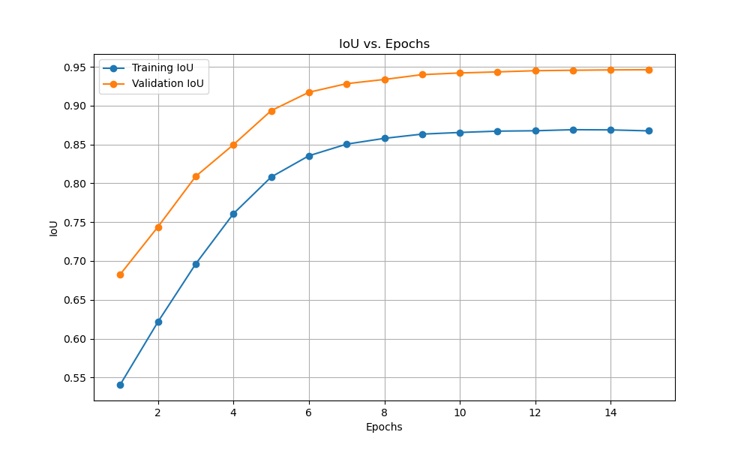
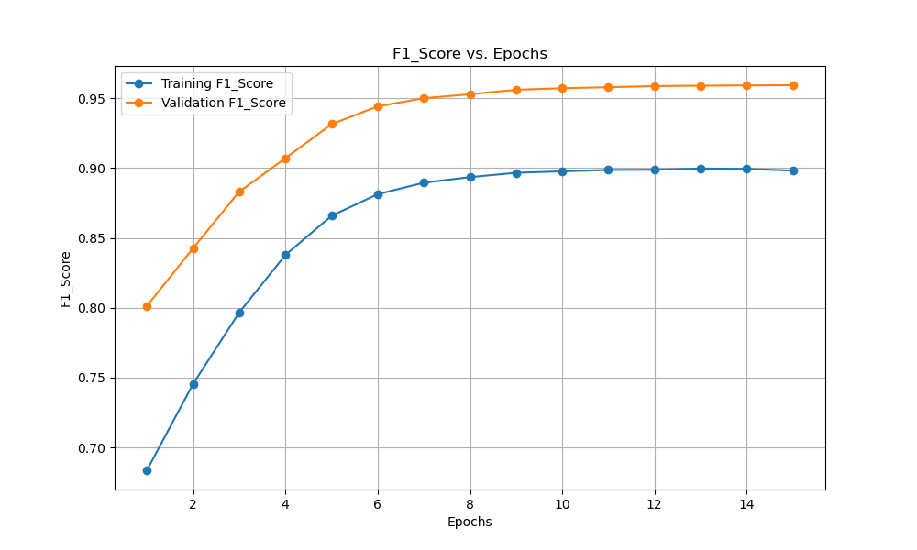
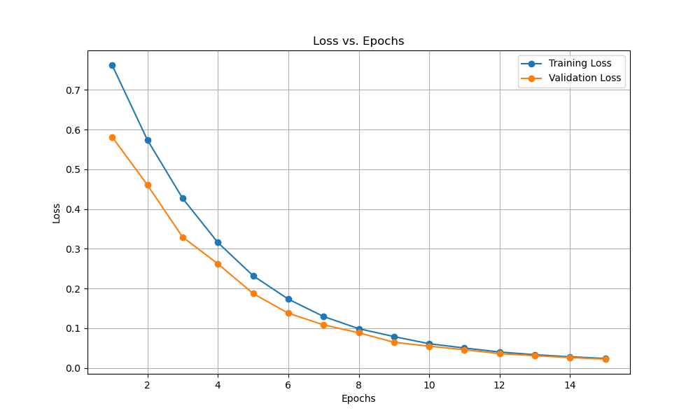
Result- FCN
Evaluation metrics: F1 scores, Loss, IOU
Evaluation Metrics | Value
F1 score | 0.968
Validation Loss | 0.031
Validation IOU | 0.947
Notes:
Smaller batch size for

Slide 24
Conclusion
In this project, our goal is to identify efficient methods for assessing building damage based on satellite imagery combined with deep learning models.
By the end of this term, we implemented and evaluated the performance of CNN, U-NET, and FCN models trained on xBD dataset.
Next step we will keep working on the current models we have and tune the hyper parameters to enhance the models’ performance.
Due to the large size of input data, the training time was longer than we expected. In the next semester, we should pay more attention to time management.

